Slide 1
Contextual Markov Decision Processes
Zhou Zhenyu

Slide 2
Contextual Markov Decision Processes
Introduction
Problem Definition
Solution:CECE general framework
Experiments

Slide 3
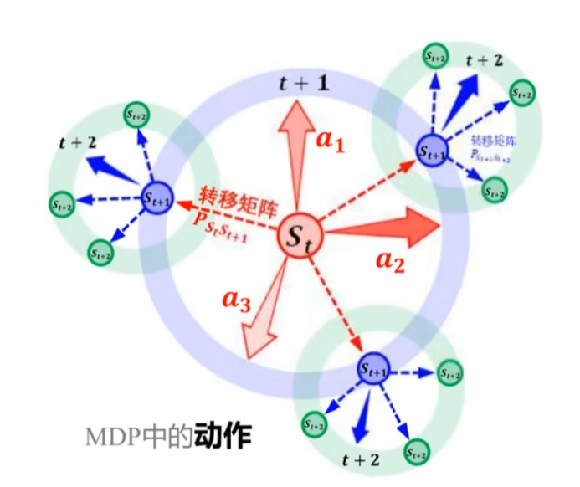
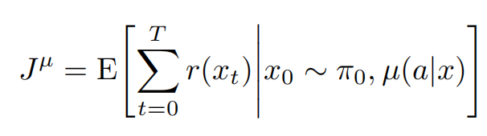

Introduction
In general, the learner’s goal is to maximize the following value function:
where the expectation is taken over trajectories with respect to the policy µ(a|x) and the initial distribution π0.

Slide 4



Introduction
surfing ads
surfing ads
p=0.6
p=0.1
initial state
Push shopping ads
initial state
Push shopping ads
r=0.2
r=10.3
p=0.4
p=0.9
closing ads
closing ads
r=0
r=0
Contextual Markov Decision Process (CMDP) is a tuple
where C is called the context space, S and A are the state and action space correspondingly, and M is function mapping any context c ∈ C to an MDP

Slide 5
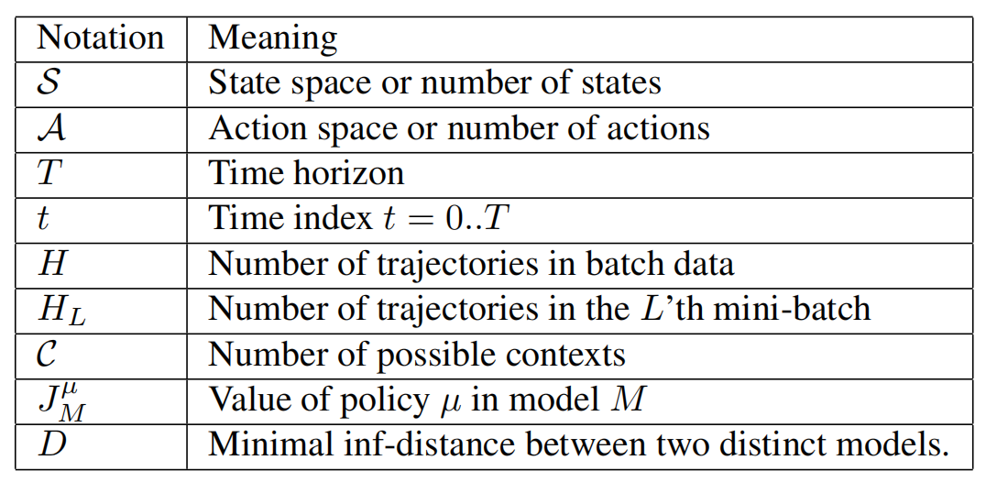
Problem Definition
The time axis is divided into H episodes, denoted by e1, . . . , eH. In the beginning of each episode, the environment chooses a context c ∈ C(random).
A trajectory of length T is generated where T is a stopping time.
Then, for the chosen MDP interaction is applied until the end of the trajectory.
The goal is maximizing over the cumulative rewards from all trajectories by the H’th trajectory, for increasing H.

Slide 6
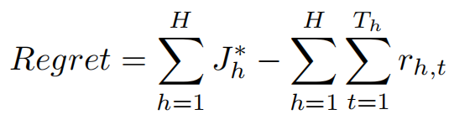
Problem Definition
For the problem of finite sources episodic CMDP we define the regret over H trajectories to be:

Slide 7
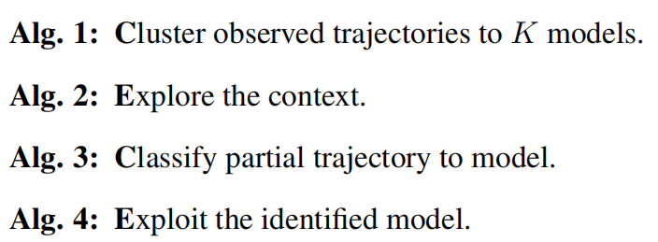
Solution:CECE general framework
the CECE general framework (Cluster-Explore Classify-Exploit) partitions the trajectories to mini batches.
In the beginning of each mini-batch, all previously seen trajectories are used to form K distinct models through Algorithm 1 (Cluster).
Then, for each new trajectory in the current mini-batch the agent generates a partial trajectory using Algorithm 2 (Explore).
The partial trajectory is then classified to a context by Algorithm 3 (Classify).
Finally, Algorithm 4 sets the policy for the remainder of the trajectory (Exploit).

Slide 8
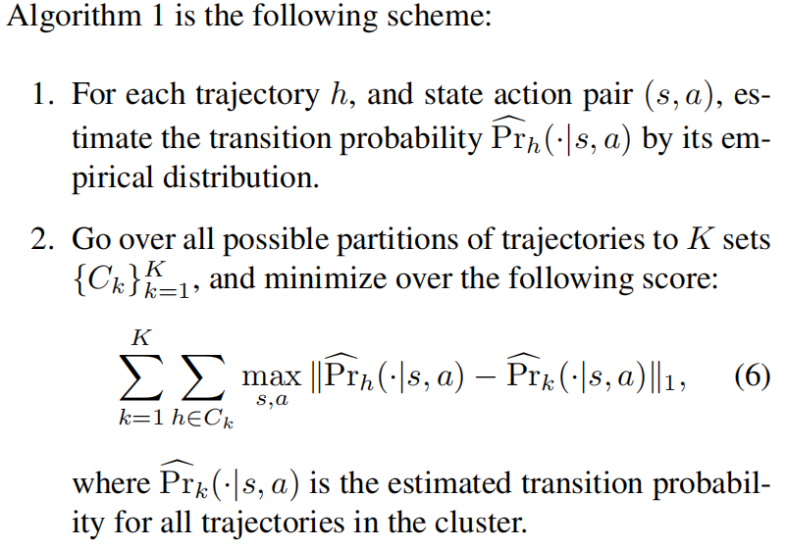
Solution:CECE general framework

Slide 9
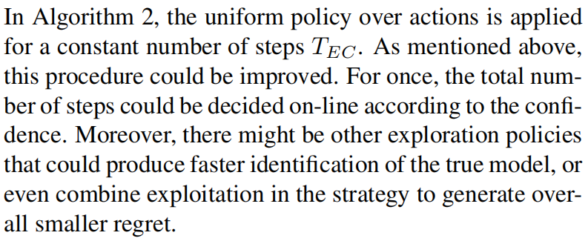
Solution:CECE general framework

Slide 10
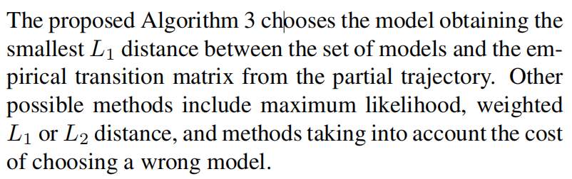
Solution:CECE general framework

Slide 11
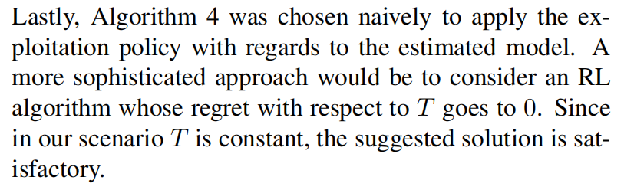
Solution:CECE general framework

Slide 12
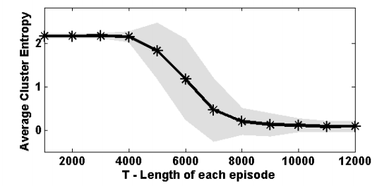
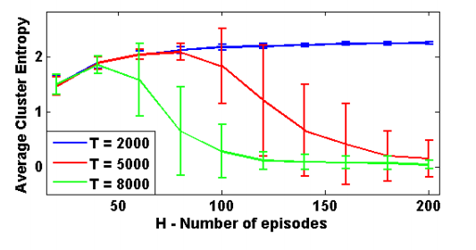
Experiment 1
Experiment Setting of CECE cluster part: K=5,|S|=100,|A|=2
When the trajectories are perfectly clustered, for each context the entropy will be 0!
Phase Transition!

Slide 13
Experiment 1-Conclusion
There is a phase transition in the clustering performance with respect to T（4000-8000）.
If the trajectories are too short, the clustering will fail even when increasing the number of episodes.
If the trajectories are sufficiently long, additional episodes improve the clustering quality
Phase Transition!

Slide 14
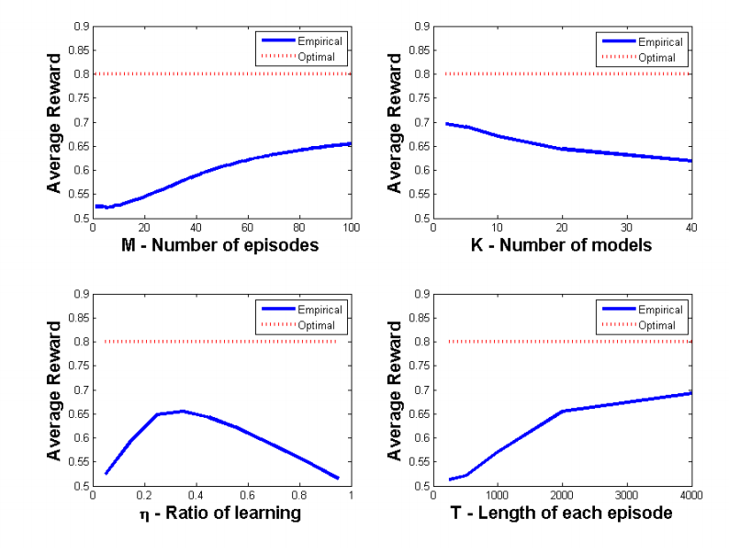
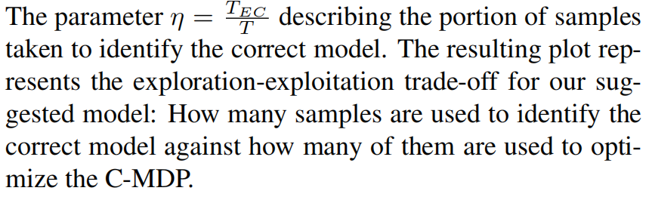
Experiment 2
Experiment Setting of full CECE: K=20,|S|=100,|A|=4,H=100,T=2000
Interesting Result!

Slide 15
Conclusion
The computational complexity of the current algorithm is too high!
Reward oriented context classification can lead to improved overall regret.
Other schemes to solve CMDPs……such as POMDPs？

Slide 16
Thanx！

